Slide 1
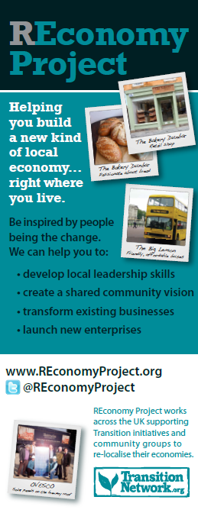
REconomy Project
Resilience outcome
More than profit
Respect resource limits
Appropriate localisation
Serves the community
… and big enough to provide the jobs and goods we need

Slide 2
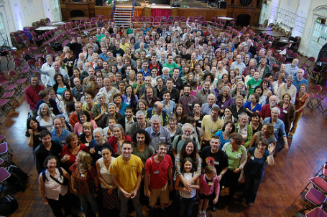
REconomy Project helping you build a new kind of local economy, right where you live
Leadership
Why we need a new economy
Enterprises and system features
How to lead the changes
Economic evaluation
Vision
What’s the purpose?
How is it different to today?
What will enable it to happen?
Workshop guides and samples
Transform businesses
Who is ready for change?
Building relationships
Examples and business cases
Services and support
Start enterprises
Inspiration and stories
Ways to support entrepreneurs
Incubators, mentors, coaching
Investment readiness

Slide 3
REconomy Project – on the ground
GET INSPIRED
Build collective vision
Identify opportunities
Share inspiring stories
Connect entrepreneurs
Livelihood shifters, youth
GET HELP
In all business aspects via
Mentoring
Coaching
Training/workshop
DIY / self-service
Totnes Engine Room
GIVE BACK
Membership & fees
Mentor new enterprises
Training/apprenticeships
Sponsor/donate
Report data
GET MONEY (e.g. <£100k)
Access to local investors
Crowd funding, Community shares/bonds, Green angels, Credit Union, Micro-finance
GET MONEY
(e.g. >£100k)
Access to Investment Readiness Programme

Slide 4
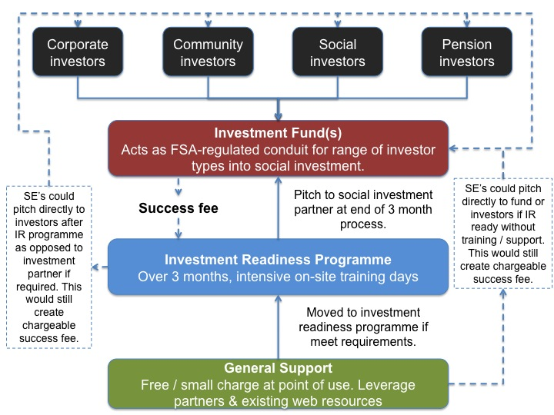
REconomy Project - investment readiness
1. Lack of investment readiness
2. Lack of appropriate finance
3. Acute dependence upon grant-funding
4. Lack of knowledge-sharing opportunities
Inspiration and support for new enterprises
Building a pipeline of enterprises needing an investment readiness programme

Slide 5
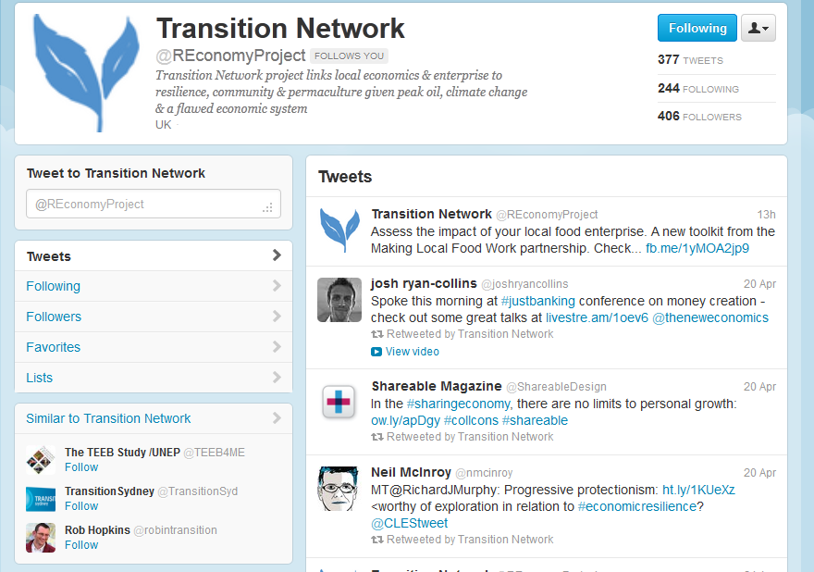
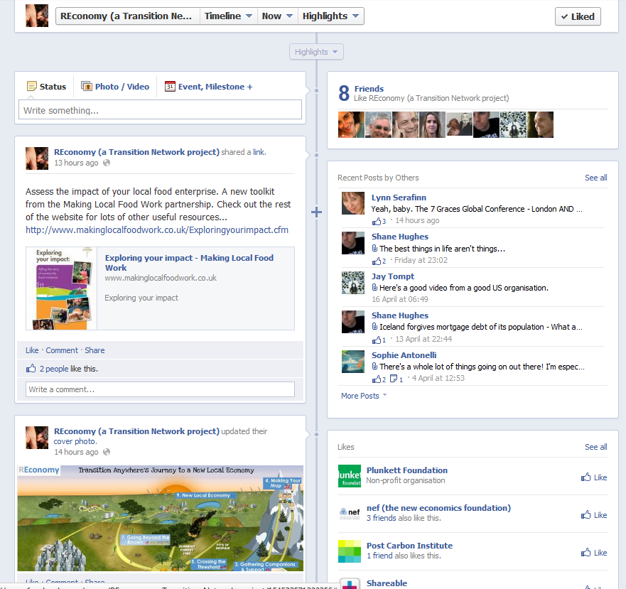
Join us…
TN conference, Battersea
Sep 13th 2012

